Slide 1

18ECE340T- MACHINE PERCEPTION WITH COGNITION
UNIT-2
Connectedness and Object Labelling and Counting
Shape models and Shape recognition
Reference Book:
Computer and Machine Vision by E.R.Davies

Slide 2
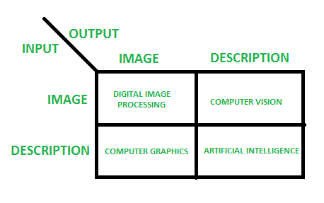
Review

Slide 3
Phases of Image Processing
1.ACQUISITION– a) Scaling and b) Color conversion(RGB to Gray or vice-versa)
2.IMAGE ENHANCEMENT– extract some hidden details from an image and is subjective.
3.IMAGE RESTORATION –deals with appealing of an image
4.COLOR IMAGE PROCESSING – deals with pseudocolor and full color image processing color models are applicable to digital image processing.
5.WAVELETS AND MULTI-RESOLUTION PROCESSING – foundation of representing images in various degrees.
6.IMAGE COMPRESSION - deals with image size or resolution.
7.MORPHOLOGICAL PROCESSING - deals with tools for extracting image components that are useful in the representation & description of shape.
8.SEGMENTATION PROCEDURE - includes partitioning an image into its constituent parts or objects.
9.REPRESENTATION & DESCRIPTION - follows output of segmentation stage, choosing a representation is only the part of solution for transforming raw data into processed data.
10.OBJECT DETECTION AND RECOGNITION - process that assigns a label to an object based on its descriptor.

Slide 4
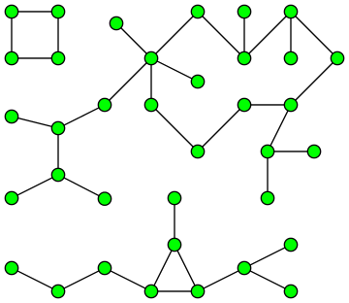
What are connected components?
Basically, it allows us to detect objects with irregular shapes and sizes based on the pixels’ connectivity to their neighbors.
However, the use of connected components operations heavily relies on adequately cleaning the image using morphological operation.
Connected Components are subgraphs of a connected graph in which any two vertices are connected to each other by paths, and which is connected to no other vertice in the supergraph.

Slide 5


What are connected components?
Connected Components in an image are set of pixels with the same value connected through Four Pixel Connectivity or Eight Pixel Connectivity.
Four Pixel Connectivity connects all pixels that have the same value along the edges.
Eight Pixel Connectivity connects all pixels that have the same value along the edges and corners

Slide 6
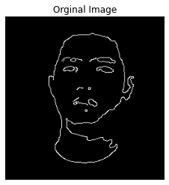
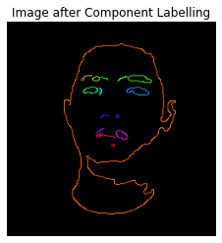
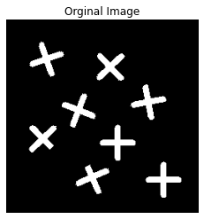
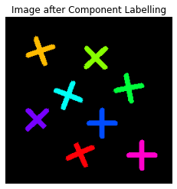
Connected Components Labelling
Connected Component Labeling is used in computer vision using binary images to detect connected regions.
Color images and higher dimensional data can also be used.
It solves the problem of finding out parts of the image that are connected physically, irrespective of color.
The Connected Components also known as Blobs can be counted, filtered and tracked.

Slide 7
Connected Components Labelling Algorithm
Various methods can be used for Connected Component Labeling:
Recursive Tracking (almost never used)
Parallel Growing (needs parallel hardware)
Row By Row (Most Common)
Classical Algorithm
Efficient Run Length Algorithm (developed for speed in industrial applications)

Slide 8
Connected Components Labelling Algorithm
The Classical Algorithm is called so because it is based on the Alassical Connected Components Algorithm for graphs, was described in 1966, by Rosenfeld and Pfaltz. The algorithm makes two passes over the image:
The first pass to record equivalences and assign temporary labels.
Th second pass to replace each temporary label by the label of its equivalence class.

Slide 9
Connected Components Labelling Algorithm
The First Pass:
Each pixel is checked from the top left corner to the bottom right corner moving linearly. If we are considering the pixel p, we will check only the pixel above it and the pixel to the right.
Step 1:
The first step involves checking, if we are interested in a pixel or not. We are interested in foreground pixels, which in binary images are represented by a pixel value of 255 (White). If the image is not of interest we simply ignore it and move onto the next step.
Step 2:
In this step if we are interested in pixel p. We fetch the labels of the pixels above and to the left of p and store then A and B.
The following cases can arise:
The pixels above or to the left or both are foreground pixels: Proceed as normal Both are background pixels: In this case, we create a new label and store it in A and B.

Slide 10
Connected Components Labelling Algorithm
The First Pass:
Step 3:
In this step we figure out which one out of A and B is smaller and assign that value to p.
Step 4:
If we have a situation where pixel above p has a label A and the pixel to the left of p has a label B. We know that these pixels are connected as pixel p connects them. Hence we need to store in information that the labels A and B are actually the same.
We do this by using the Union-Find Data Structure. We set the larger label as the child of smaller label.
Step 5:
Go to the next pixel.

Slide 11
Connected Components Labelling Algorithm
The Second Pass:
In the second pass the algorithm goes through each pixel again and checks the label of the current pixel.
If the label is a 'root' in the Union-Find Data Structure, it goes to the next pixel.
If not it follows the links to the parent till it reaches the root after which it assigns that label to the current pixels.

Slide 12
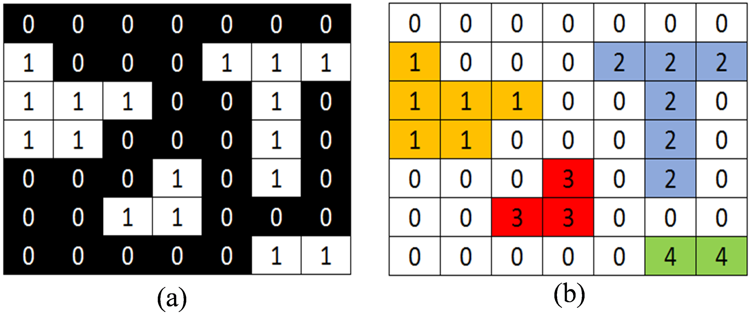
Connectedness Component Labelling
(a) Simple binary image for labelling input (b) labelling result using CCL method

Slide 13
Connected Components Labelling Algorithm

Slide 14
Connectedness Component Labelling
Connected Component Labelling (CCL) is one of available technique used to classify object or region on digital imaging research field.
This technique apply connectivity theory between pixels exist on image. The pixels on a specific region is connected while all of them have same value and restricted by background. Every label resulted after CCL process is unique and separated minimun by on background space.

Slide 15
Connectedness Component Labelling
CCL method is able to perform labelling every connected region using unique label (using label entry).
Therefore, by keeping information about total used label on it, the number of object existed on binary image will be known.
Another information can be determined such as object area, object height, and object center.

Slide 16
Connectedness Component Labelling Method - Steps
1. Check the first pixel value on input image ( first column and first row)
2. If pixel value is 0 (background), skip and move to next column of pixel but still in same row.
3. If pixel value is 1 , check its neighbour value and use terms below :
If its nearest neighbour still not labelled yet, label this pixel using label 1.
If only one of nearest neighbour was labelled, give same label to this pixel using neihbour’s label.
However, if there were 2 or more labels exist on neighbours, use the smallest label to label this pixel.
After labelling each pixel and skipping the background, don't forget to update the label.
4. Perform this process on entire columns and rows.

Slide 17
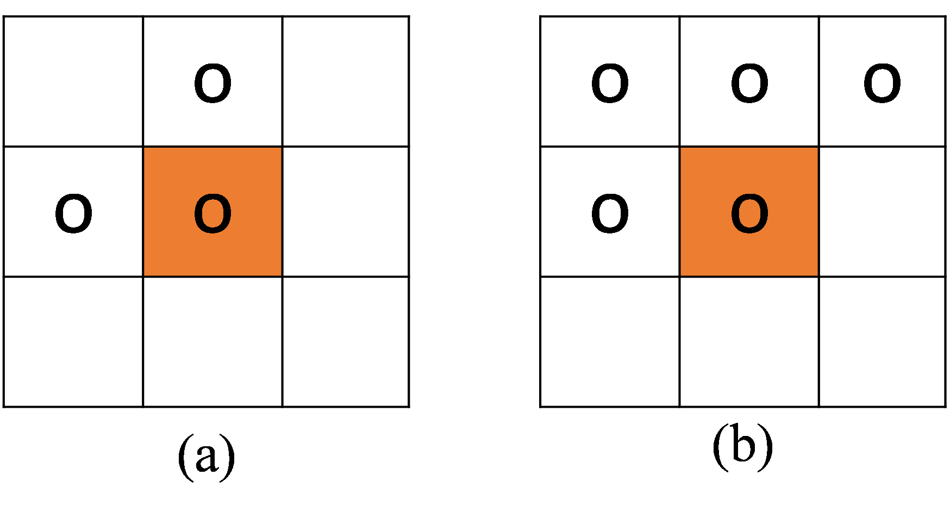
Connectedness Component Labelling Method - Steps
Labelling result using CCL method depends on connectivity configuration used in neighbour's label checking. There are 2 connectivity cofiguration can be used in CCL method as follows:
(1) 4 connectivity
(2) 8 connectivity
By using 4-conectivity, pixel value checking only performed on
2 nearest neighbours (west and north neighbhour)
and 8 connectivity uses 4 point checking.
4 connectivity
8connectivity

Slide 18
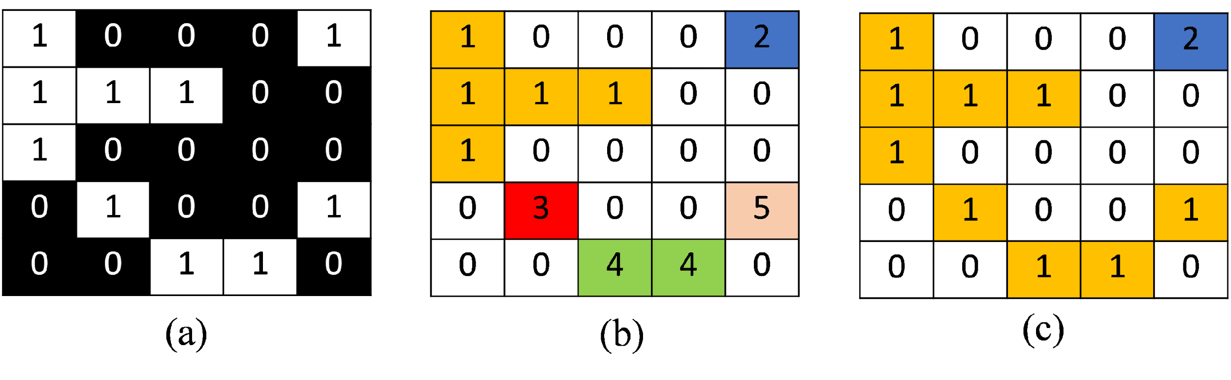
Connectedness Component Labelling Method - Steps
(a) Binary input image, (b) labelling result using 4-connectivity, (c) labelling result using 8-connectivity
Advantages and disadvantages caused by number of connectivity selection is determined by this method application.
As an example, 4 connectivity configuration could not detect slanted object, but it can be performed faster than 8 connectivity because it only check for 2 neighbours.
However, 8 connectivity is able to detect more complex objects even though need longer time to perform this method.

Slide 19
Shape Models and Shape Recognition
The extraction of quantitative feature information from images is the objective of image analysis.
– Shape quantification
– Count the number of structures
– Characterize the shape of structures
The most common object measurements made are those that describe shape.
– Shape measurements are physical dimensional measures that characterize the appearance of an object.

Slide 20
Shape Models and Shape Recognition
The performance of any shape measurements depends on the quality of the original image and how well objects are preprocessed.
– Object degradations such as small gaps, spurs, and noise can lead to poor measurement results, and ultimately to misclassifications.
– Shape information is what remains once location, orientation, and size features of an object have been extracted.
– The term pose is often used to refer to location, orientation, and size.

Slide 21
Shape Descriptors
What are shape descriptors?
– Shape descriptors describe specific characteristics regarding the geometry of a particular feature.
– In general, shape descriptors or shape features are some set of numbers that are produced to describe a given shape.
–The shape may not be entirely reconstructable from the descriptors, but the descriptors for different shapes should be different enough that the shapes can be discriminated.
– Shape features can be grouped into two classes:
boundary features and region features

Slide 22
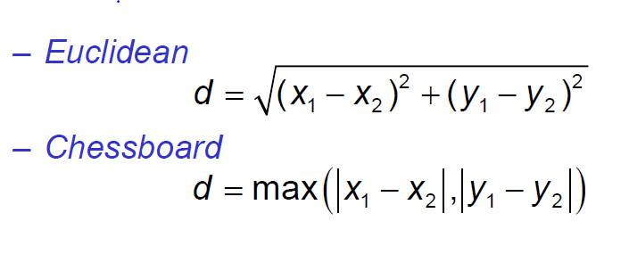
Distances
The simplest of all distance measurements is that between two specified pixels (x1,y1) and (x2,y2).
There are several ways in which distances can be defined

Slide 23
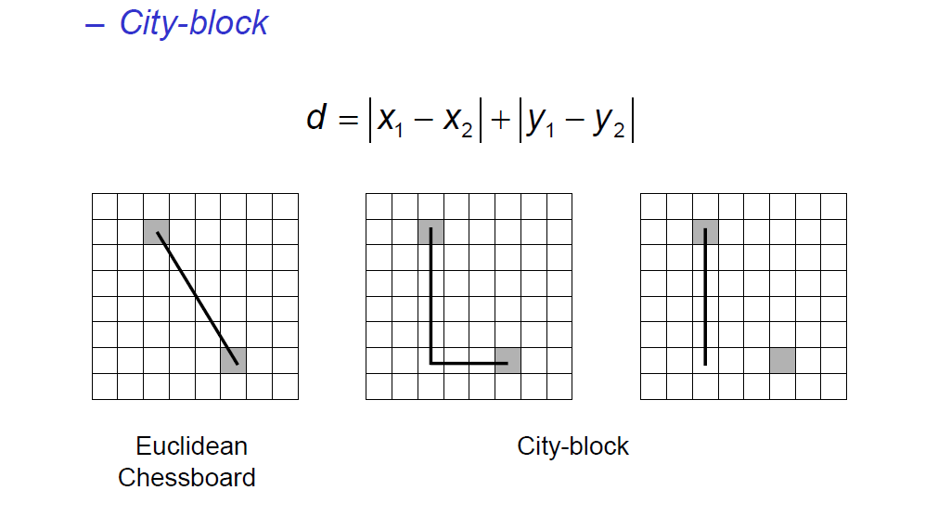

Slide 24
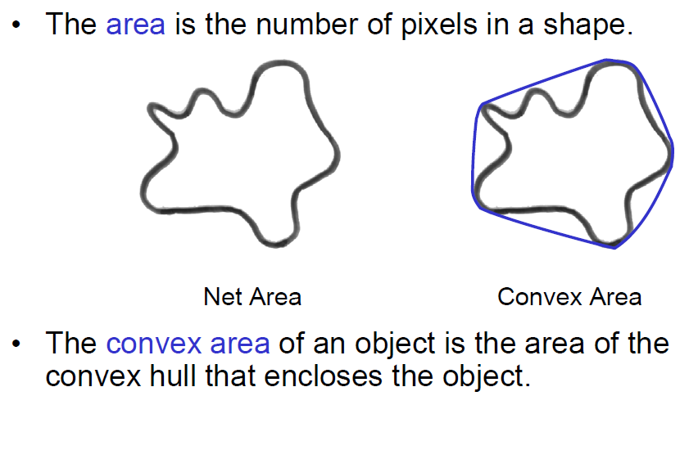
AREA

Slide 25
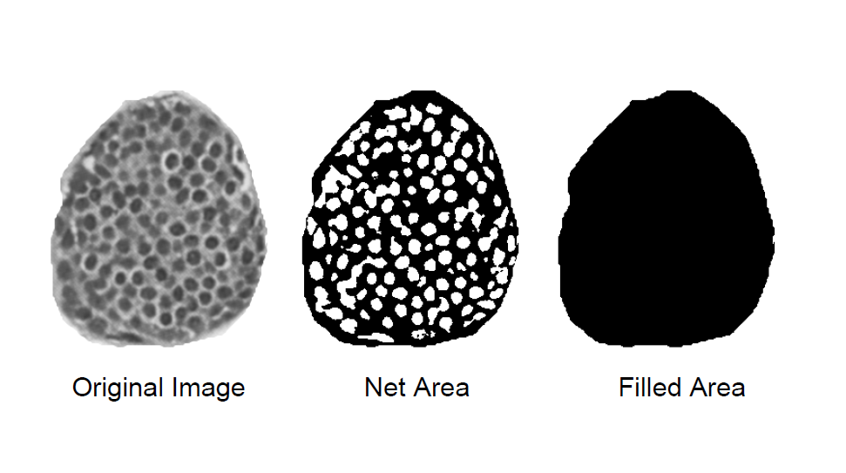
AREA

Slide 26
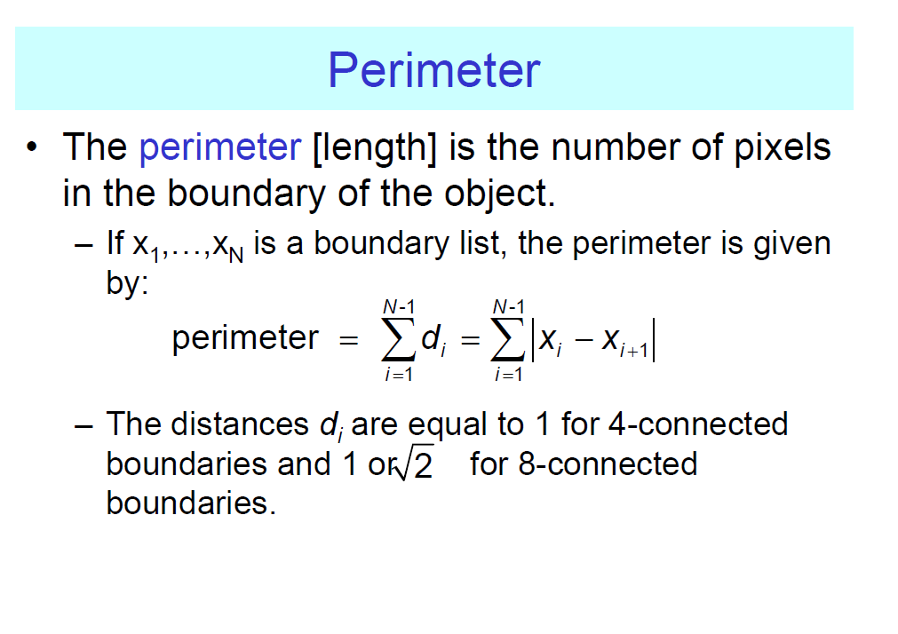

Slide 27

For instance in an 8-connected boundary, the distance between diagonally adjacent pixels is the Euclidean measure
– The number of diagonal links in N4–N8, and the remaining N8–(N4–N8) links in the 8-connected boundary are of one pixel unit in length.

Slide 28
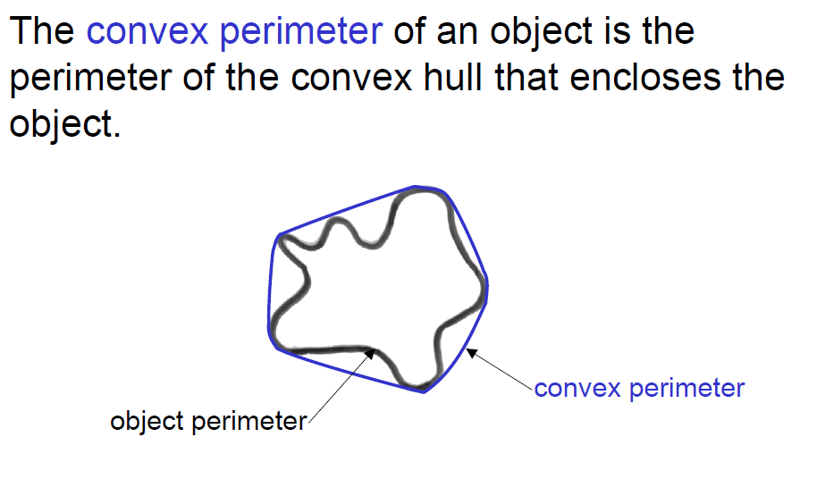
PERIMETER

Slide 29
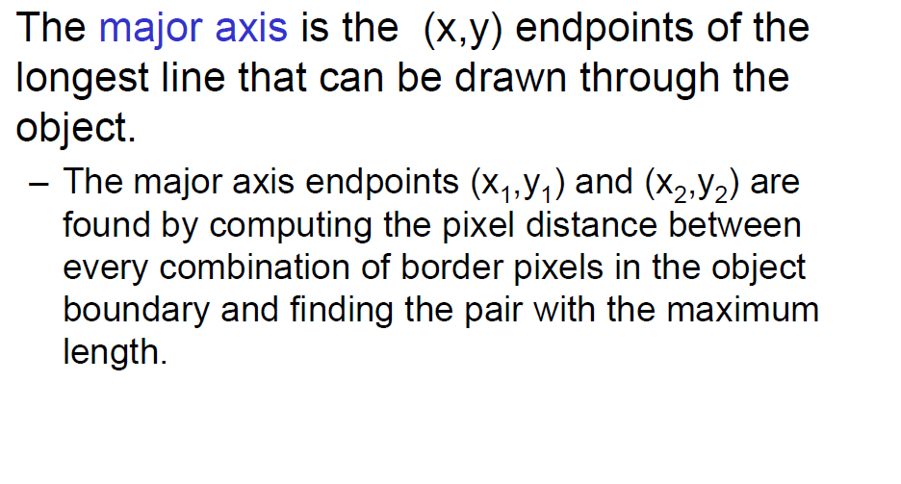
MAJOR AXIS

Slide 30
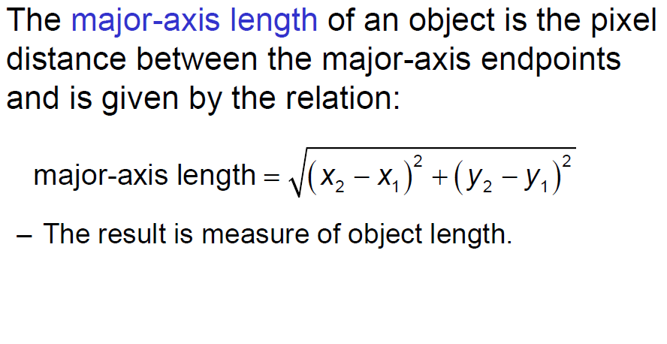
MAJOR AXIS LENGTH

Slide 31
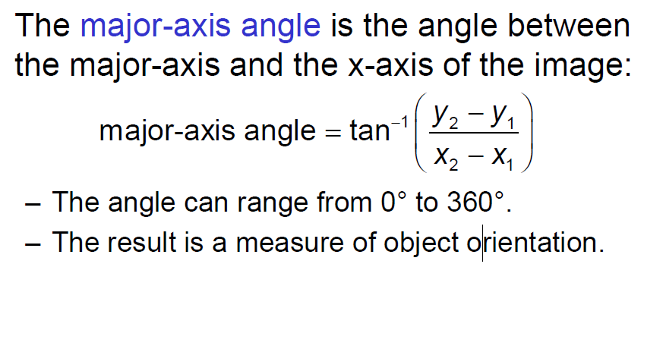
MAJOR – AXIS ANGLE

Slide 32
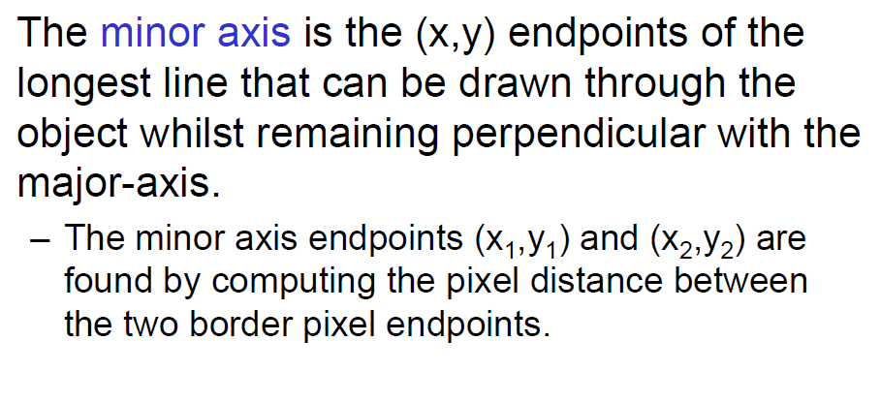
MINOR AXIS

Slide 33
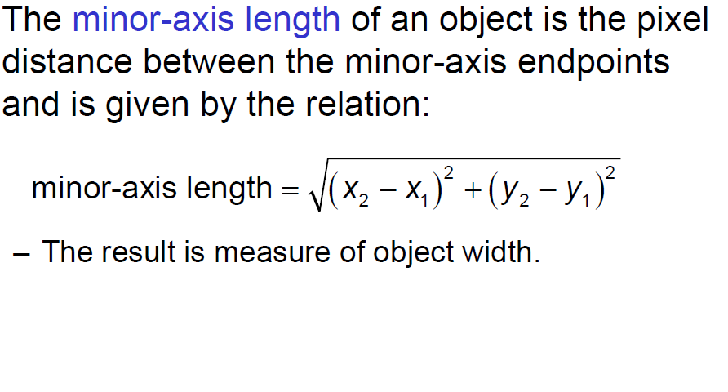
MINOR – AXIS LENGTH

Slide 34
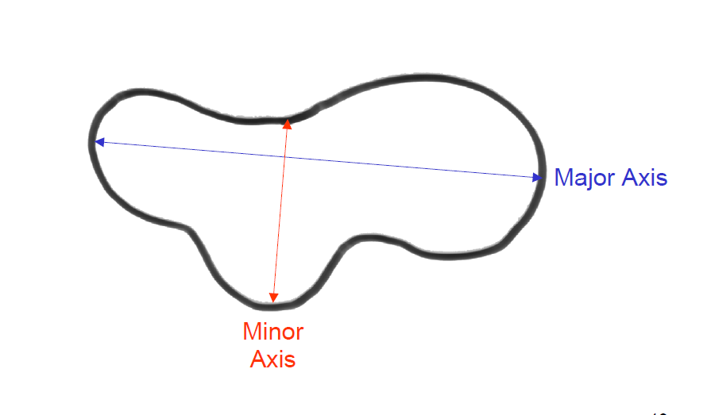
MAJOR AND MINOR AXES

Slide 35
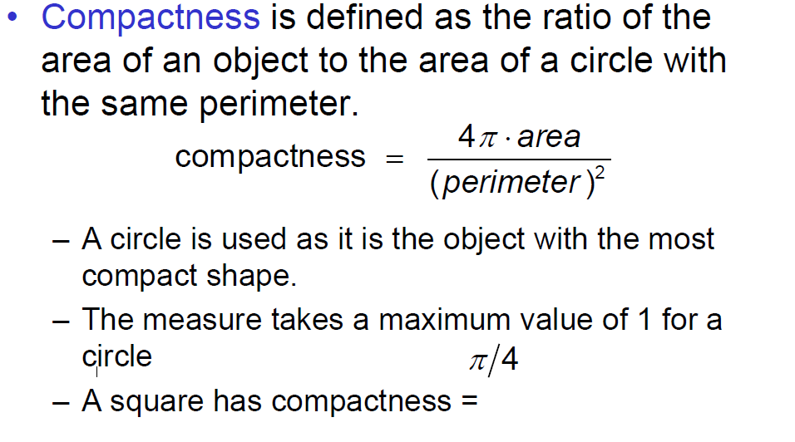
COMPACTNESS

Slide 36
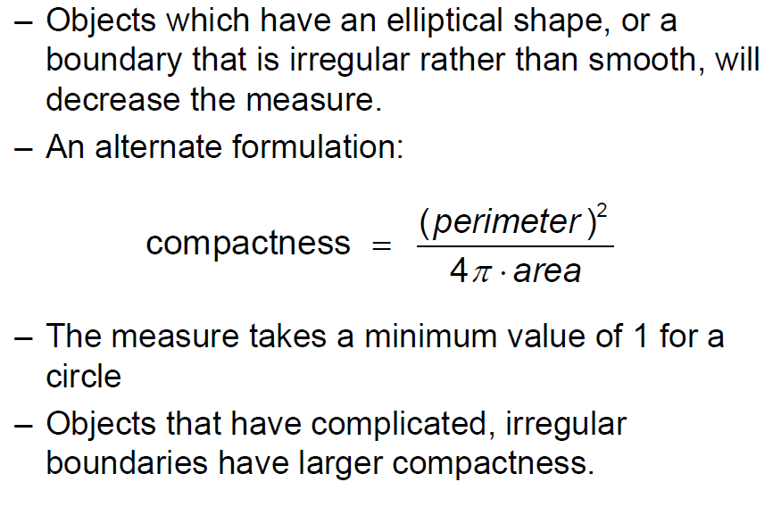

Slide 37
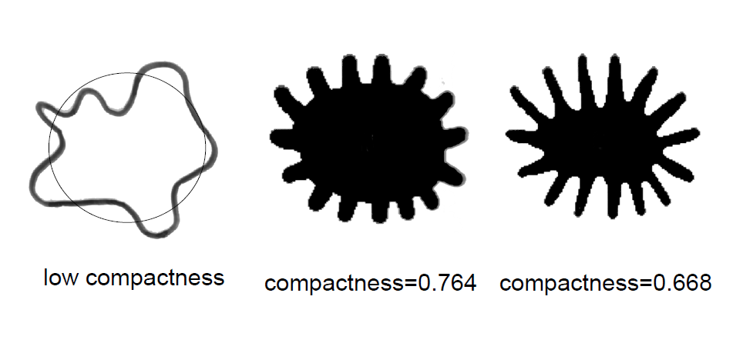
COMPACTNESS

Slide 38
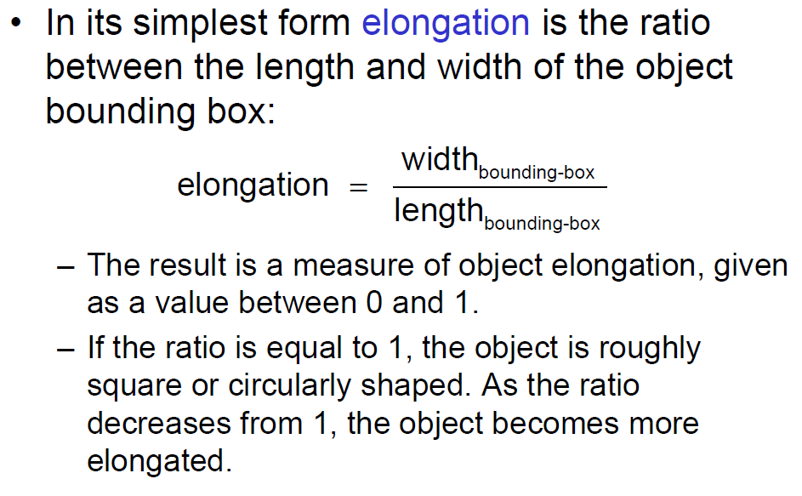
ELONGATION

Slide 39
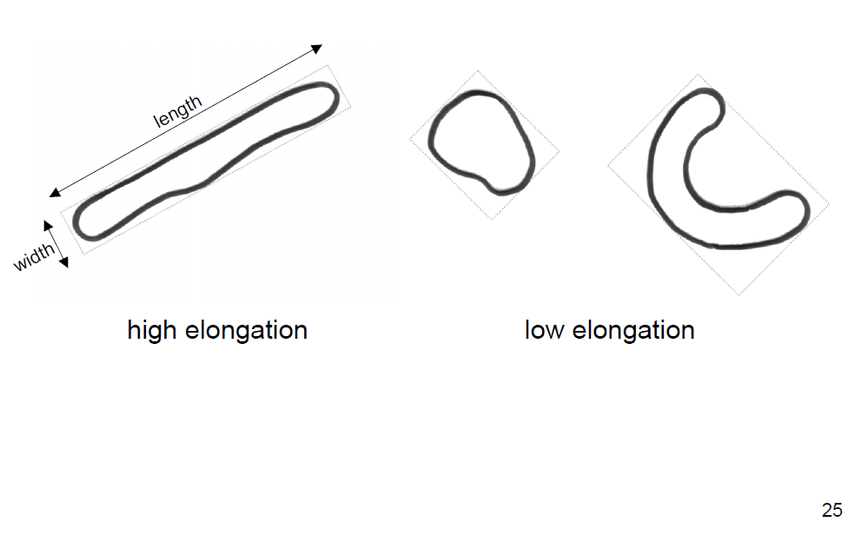
ELONGATION

